Slide 1
Serverless Patterns with Azure Functions
Kevin Harris
Azure GBB TSP for CAD
Microsoft

Slide 2


Slide 3
What is “serverless”
Abstraction of servers
Event-driven scale
Sub-second billing
Notes:
Abstraction of servers, infrastructure and configuration of operating system
Event-driven scale
Sub-second billing
Stateless
Serverless compute is a fully managed service. Some refer to it as Functions as a Service
OS and Framework patching is performed for you
There is zero administrative tasks and no need to manage any infrastructure
You just deploy your code (function) and it runs
Your code runs within seconds and for very short period of time
Serverless compute scales quickly (almost instantly) and vastly
Automatically scales within seconds
No scale configuration is required (there is no way to configure scale or limits)
Scales to match any given workload. Scales from zero to handle tens of thousands concurrent functions invocations within seconds
Pay only for the time your code is running
Serverless compute reacts to events
React, in near real-time, to events and triggers
Triggered by virtually any event from Azure service or 3rd party services

Slide 4
How is it different
Mono-lithic application
Inside client app
Complex framework
Loosely coupled components
Outside client app
Micro-functionality
Notes:
Mono-lithic application -> loosely coupled components
Events happening async outside client application
Build/use micro-functionality to react to a single event

Slide 5
Benefits of “serverless”
Ship faster
Reduced dev ops
Focus on business logic
Notes:
“Pinnacle of PaaS compute”
Not just hardware “servers”, but software servers are also managed for you
Focus on business logic, not solving technical problems not core to business
Lower effort to get started makes it easier to experiment (bots, etc.)

Slide 6
Signs that a serverless pattern might be useful for a given scenario
Stateless → Scale
Not worth deploying a traditional backend
Workload is sporadic (very low & high scale)
Dev ops favored versus dedicated ops
Lots of different services involved that need “glue”

Slide 7
Applications
Example: Timer based processing
Eve
r
y 15 minutes
Find and clean invalid data
Clean table

Slide 8
Applications
Example: Azure service event processing
CSV
File added to
T
ransfo
r
m CSV to data
r
ows
P
ower BI
Blob Storage
Cha
r
t graphic

Slide 9
Applications
Example: SaaS event processing
Excel file saved
Mic
r
os
o
f
t Graph API analyzes content
C
r
eates new sheets
to OneDrive
with cha
r
ts

Slide 10
Applications
Example: Serverless Web Applications architectures
Loaded web page
C
r
eate ad based on user p
r
o
file
Completed page
calls
W
ebHook

Slide 11
Async background processing
Example: Serverless Mobile back ends
Photo taken and
Sto
r
es in blob storage
P
r
W
ebHook called
oduces scaled images

Slide 12
Applications
Example: Real-time stream processing
Millions
o
f devices feed
T
ransfo
r
m to structu
r
ed data
Sto
r
e data in
into St
r
eam Analytics
SQL Online

Slide 13
Applications
Example: Real-time bot messaging
...
?
Co
r
tana Analytics answe
r
Message sent
s questions
Chatbot sends
to Chatbot
r
esponse

Slide 14


Integration
Example: Invoice Processing
API Management
Logic App
Function
Post new invoice
Convert to JSON
Grab raw file
Store record
API layer
Fetch Invoice
Notes:
Chris

Slide 15
Suggestions for getting started
For existing services, start small. Replace 1 API or background processing item.
Integration is a great place to introduce serverless, because it is often a new layer on top of old layers.
Have fun with it – build something that makes your life easier that wouldn’t normally justify buying a whole server for.

Slide 16


























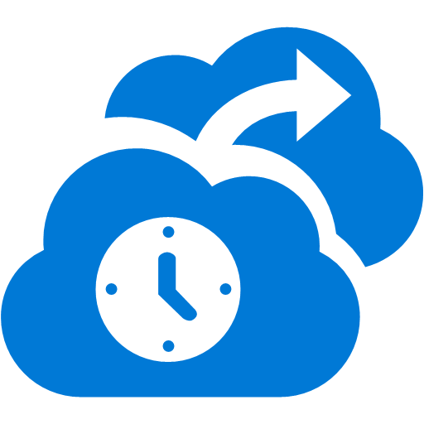







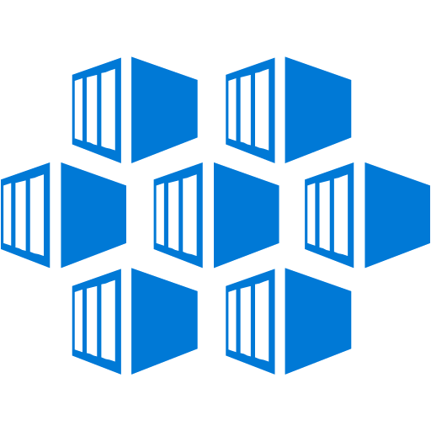





























Platform Services
Security & Management
Hybrid
Cloud
Media & CDN
Application Platform
Data
Security Center
SQL
Database
Azure AD
Health Monitoring
Media Services
Media Analytics
Content Delivery
Network
Web
Apps
Mobile
Apps
SQL Data
Warehouse
DocumentDB
Portal
AD Privileged
Identity
Management
Azure Active
Directory
Integration
SQL Server
Stretch Database
Redis
Cache
Storage
Tables
Azure
Search
API
Apps
Cloud
Services
Azure AD
B2C
API
Management
BizTalk
Services
Domain Services
Service
Fabric
Notification
Hubs
Intelligence
Multi-Factor
Authentication
Logic
Apps
Service Bus
Functions
Cognitive Services
Bot Framework
Cortana
Backup
Automation
Developer Services
Analytics & IoT
Operational
Analytics
Compute Services
Scheduler
HDInsight
Machine
Learning
Stream Analytics
Container
Service
VM
Scale Sets
Visual Studio
Mobile
Engagement
Import/Export
Key Vault
Data
Catalog
Data Lake
Analytics Service
Data Lake Store
Store/
Marketplace
Batch
RemoteApp
VS Team Services
Xamarin
Azure Site
Recovery
Application
Insights
HockeyApp
IoT Hub
Event
Hubs
Data
Factory
Power BI
Embedded
VM Image Gallery
& VM Depot
Dev/Test Lab
StorSimple
Infrastructure Services
Compute
Storage
Networking
Virtual Machines
Containers
Blob
Queues
Files
Disks
Virtual Network
Load Balancer
DNS
Express
Route
Traffic Manager
VPN Gateway
App
Gateway
Datacenter Infrastructure (32 Regions, 24 Online)
Notes:
Why this Slide:
It shows we have a very broad platform. It about BOTH IaaS and PaaS, that these work together. It shows that we continue to lead in world class IT capabilities and that there’s really nothing missing.
Key Points:
We have already seen how the Azure Platform is IaaS + Pass – but I want you to understand that this is a huge number of capabilities – IT building blocks if you will.
Every one of these blocks you provision anytime, self-service anywhere in the world 24x7. You pay for what you use, you can get more or less anytime and you can fully automate everything…
DON’T spent too much time on this slide – you are going to DEMO (aren’t you!!!)… DON’T go through each block…
Transition to NEXT Slide: Make the build go backwards to show JUST IaaS and then you will go to the demo to show it.

Slide 17








Azure Functions
Serverless
Accelerate development
Bind into services
Azure Service Bus
Azure Event Hub
Azure Storage
</>
Dropbox
Sendgrid
AzureDocDb
Event-driven scale
Reduced Dev Ops
Develop your way
Local development
OneDrive
Box
Twilio

Slide 18
Azure Functions architecture
Azure Functions is built around the WebJobs SDK runtime. The WebJobs SDK makes it easy to react to events and work with data in a consistent abstracted fashion.
App Service Dynamic Runtime
WebJobs Core SDK
WebJobs Script Runtime
Triggers
Code
Inputs/ Outputs
WebJobs Extensions
Config
Language Abstraction

Slide 19
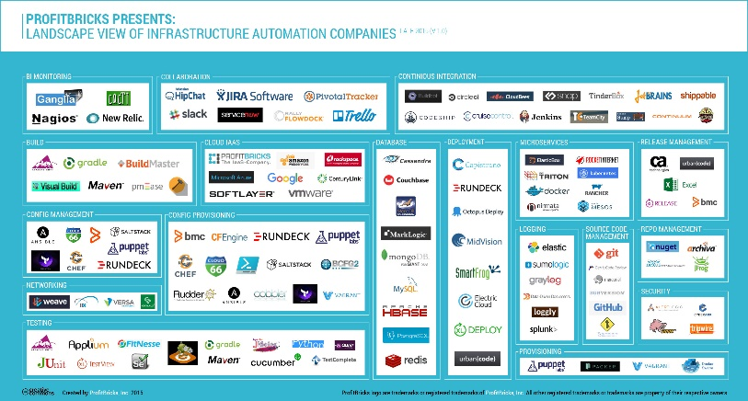
Microservice tools and approaches
Microservices in the wild
Azure Functions
Azure Service Fabric
Implication: Build your own microservices platform
Benefits: Customizable, pick best of breed solutions
Implication: Serverless microservices
Benefits: Quick ramp up, sub second metering, zero ops
Implication: Prescriptive microservices platform
Benefits: Easy to build, deploy and manage microservices at scale
Event-driven scale
No Ops

Slide 20

Dual abstraction
Serverless compute abstracts away the compute
Bindings abstract away the services you interact with
Other Services
Business Logic
Serverless PaaS

Slide 21
Platform and scaling
App Service offers dedicated and dynamic tiers.
Dedicated is the existing App Service plan tiers
Basic, Standard, Premium
Pay based on # of reserved VMs
You’re responsible for scale
Dynamic
Pay on number of executions
Platform responsible for scale

Slide 22
Dynamic tier pricing
Pay per execution model - two meters, three units
Number of executions
Duration of execution x reserved memory
First million executions free.
Free until later in Summer 2016 when full pricing info is released.

Slide 23
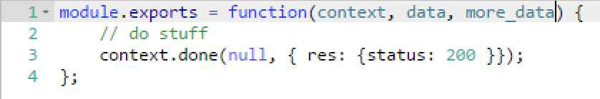
Functions programming concepts
Trigger
Input
Code
Output

Slide 24


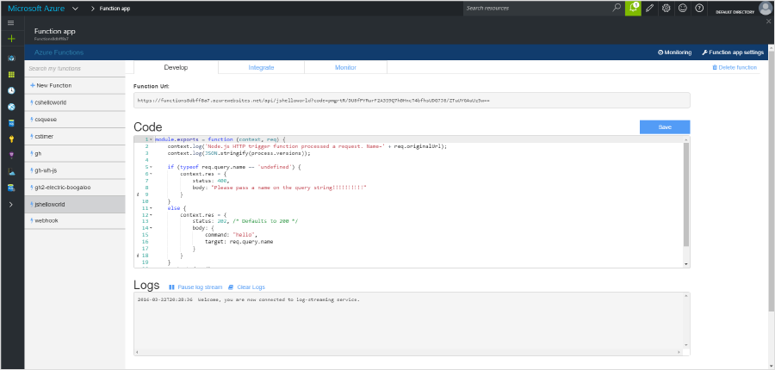
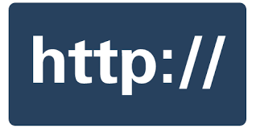


1) Trigger
2) Input Binding
3) Develop
4) Execute
5) Output Binding
Web
Hooks
App Services
Hosting Plans
Azure Services
Azure Services
Azure Services
7) Develop Locally
6) Monitor and Improve
Notes:
This is the whole (top level) Dev Ops story where Dev build wounderful apps, using CI they mange their code, builds, and releases. Connecting to a repository, they can deploy to Azure Websites, build in the cloud, deploy to a slot to test and validate, swap into production, deployed across the globe as needed, monitor and get feedback, on which devs can make updates. Rinse and repeat

Slide 25
Get started and reach out!
Try Functions – https://functions.azure.com/try
Try App Service – https://tryappservice.azure.com

Slide 26
Questions?

